Slide 1
Qualitative Evaluation Using Narrative Techniques
HartKnowledge Consulting
28th June 2012 – University of Canberra

Slide 2
Narrative (story)?
There have been great societies that did not use the wheel, but there have been no societies that did not tell stories. —Ursula K. LeGuin
In seeking truth you have to get both sides of a story. —Walter Cronkite

Slide 3
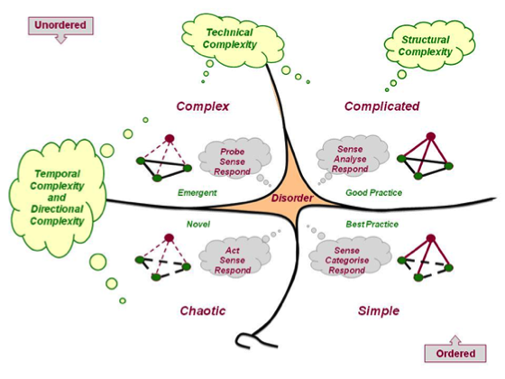
Cynefin Framework

Slide 4

Why use Narrative?
When traditional methods like surveys aren’t appropriate e.g. literacy issues.
When cultural issues make story more appropriate e.g. Indigenous.
When you have time to collect meaningful or in depth evidence.
When you are trying to identify the weak signals which may not be surfaced using other methods.
When you are trying to get people to listen to alternative views in a safe place.

Slide 5
What is an Anecdote Circle?
Anecdote circles use anecdotes of personal experiences to gain evidence of what is really happening in a complex environment
They are more open-ended than focus groups and allow for the unexpected or weak signal to surface
Focus groups are more concerned with opinions and judgements than anecdotes which are more concerned with personal experiences
Anecdotes reveal the values and behaviours of people in order to make sense of a situation or event
Anecdotes link events in a meaningful way

Slide 6

No Conversation = No Relationship
Real conversation catches fire. It involves more than sending and receiving information (Theodore Zeldin).
Everywhere you go there is a need to converse and communicate – to collect and exchange ideas and knowledge.
Sharing knowledge with your stakeholders leads to ‘knowledge elicitation’ i.e. new knowledge.

Slide 7

Using Anecdote Circles
Gathering stories and experiences using the anecdote circle.
Reading and labelling those stories/anecdotes.
Clustering the labels and looking for patterns in the anecdotes.
Labelling the clusters with goals we think we need to be striving for.
Prioritising the identified goals.
Allocating actions against the goals.

Slide 8

Anecdote Circles Rules
8-12 people in a circle.
Rules of behaviour:
  1st or 2nd hand examples;
  Don’t disagree – take the opportunity to tell your version;
  Try to let others finish their story;
  Chatham House Rule – what is said in the Anecdote Circle stays in the Anecdote Circle.
Different methods of recording the anecdotes/narrative.

Slide 9


First Exercise: Anecdote Circles
Think about a time when you were completely disgusted with (topic …) or really delighted with (topic…)
Come up with at least 10 anecdotes.
Notes:
Think about a time when you were involved in a conversation where you were absolutely thrilled by the results of the conversation or you were completely disappointed in the results?????

Slide 10
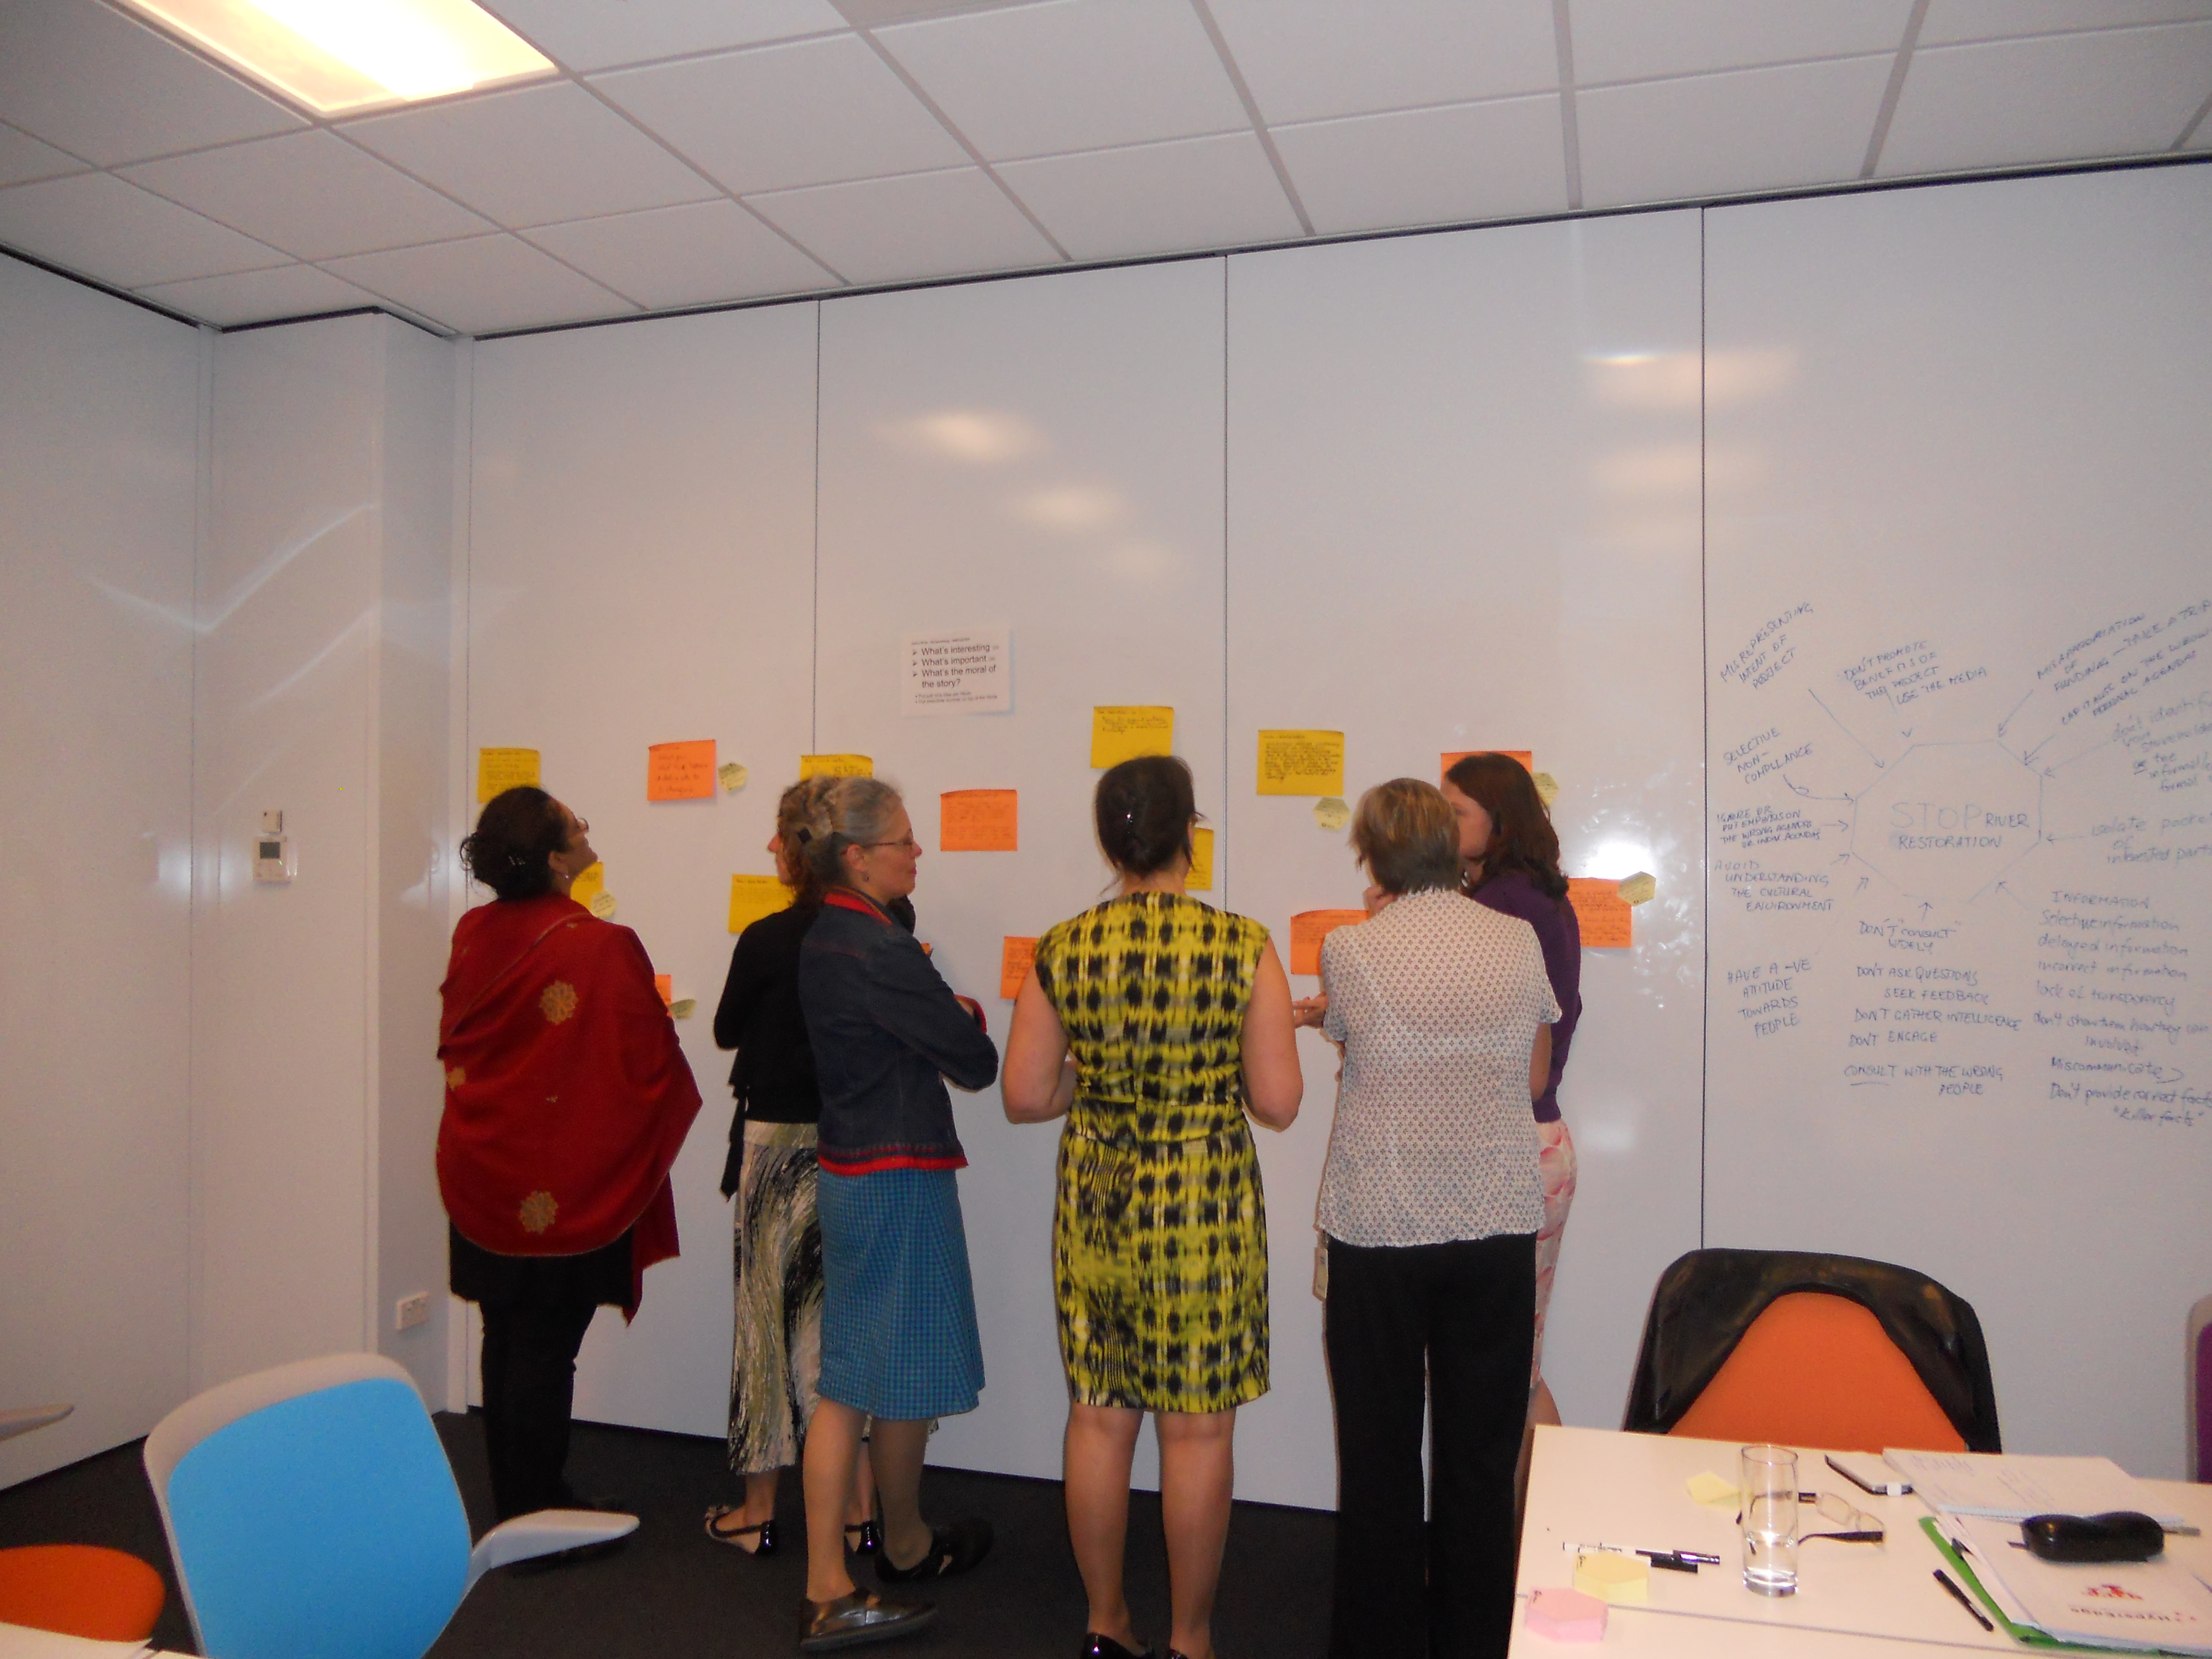
Second exercise - Making Sense – Labelling anecdotes
Work in pairs and read the anecdotes. For each anecdote write in a few words on the pink hexie one of the following:
What’s interesting OR
What’s important OR
What’s the moral of the story?

Slide 11
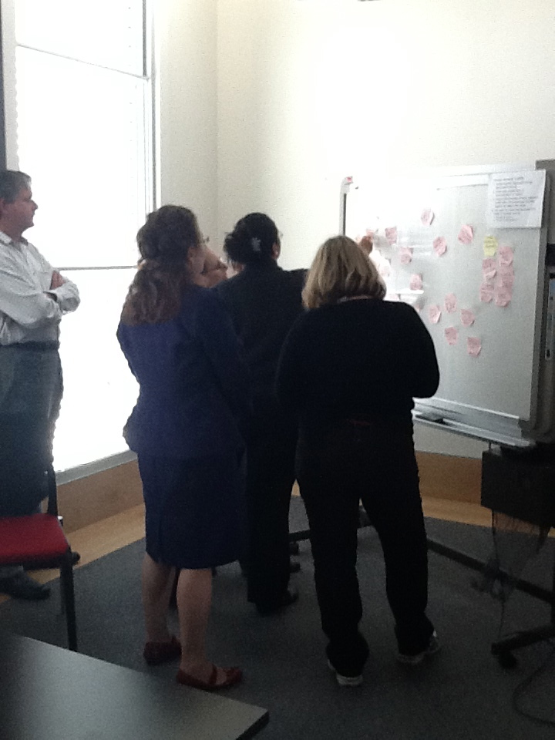
Third exercise Making Sense – Labelling clusters
Take all the post-it notes and place them on the other wall. We are now going to cluster the post-it notes around different topics.
Cluster together post-it notes with strongly associated meanings.
Avoid super-clusters such as “communication” or “culture”.
Using different coloured post-it notes, label each cluster with a short expression that links together the ideas in the cluster, for example:
  "We want to improve ..."
  "We want to foster/nurture ..."

Slide 12
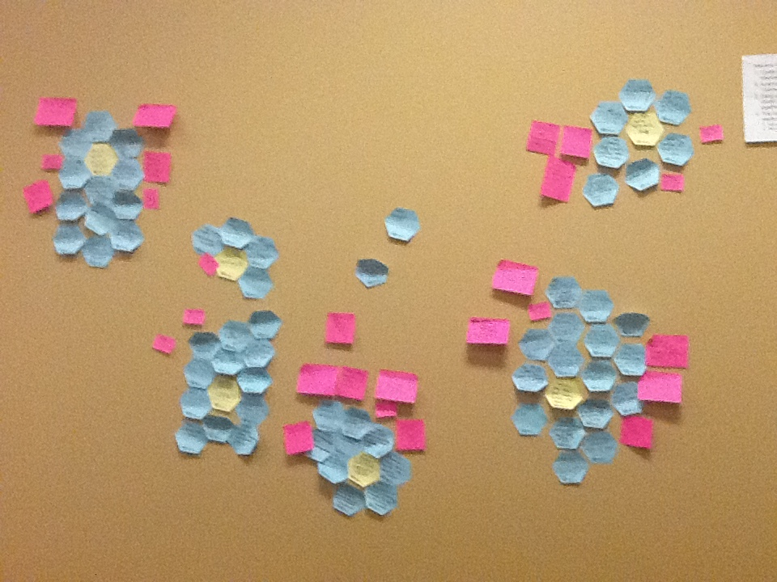
Voting on the Priority Cluster
You are given 3 pink post it notes – large, medium, and small.
Write out the name of the cluster you consider to be the highest priority for action the large post it.
Write out the second highest priority on the medium post it
Write out the third highest priority on the smallest post it
AS a group not place your post its on the clusters corresponding to first, second and third priority.

Slide 13

Actions for Improvement
After the priorities are brainstormed by the group for possible large projects and small actions, each table is to select a project.
This project is flushed out by the group as to what actions need to occur, who will be responnsible and what the first steps are
The same process is repeated for smaller actions …

Slide 14
Some Limitations
Geographic dispersal of the clients may mean you cannot get a valid sample
Getting the numbers and timing right – availability of participants – don’t schedule at religious festivals, public holidays, major sporting events ... etc.
Convincing clients that this was important and they would get to be heard

Slide 15
What are the benefits of undertaking this approach?
It’s an opportunity to explore issues that may be:
  Sensitive – due to literacy issues
  Contentious – there may be very differing viewpoints – but it is important to point out that difference is good
  Invisible – the anecdotes can surface issues that are largely hidden or not obvious
Notes:
These are some of the issues we can explore in the development of a Regional Knowledge Strategy.
Ask “Do any of these issues strike a chord with you?”.

Slide 16
References
How to run this process www.rkrk.net.au
Dave Snowden’s Cynefin Framework www.cognitive-edge.com
HyperEdge Pty Ltd www.hyperedge.com.au
HartKnowledge www.hartknowledge.com.au

Slide 17
Questions?

Slide 18

Codification
Explicit
Documents
Observable
Budgets
Structured
Database
Schematic
Org. Chart
Teachable
Procedures
Measurable
Skills
Personalisation
Tacit
Markmanship
Not Observable in Use
Innovation
Unstructured
Building Relationships
Rich
Policy Development
Not Teachable
Professional Judgement
Intangible
Group Behaviour & Norms
Notes:
18

